Slide 1

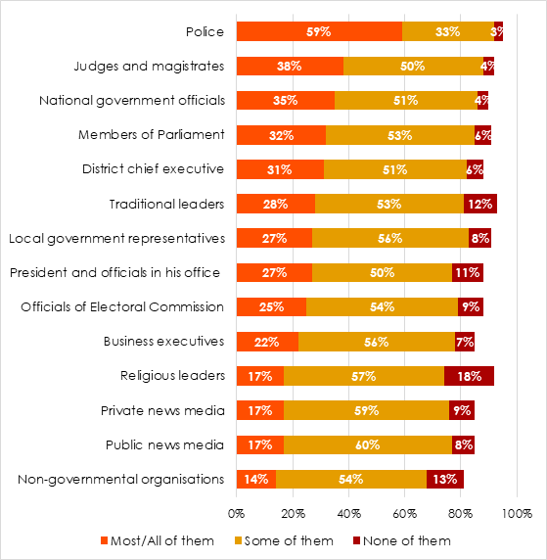
Tackling Corruption in Ghana
Danielle N. Frempong, Professor Tracy Kuperus
International Development Studies
Project Thesis
I argue that in order to dismantle socio-cultural ideologies about corruption, anti-corruption advocates must push for a new corruption-specific policy and pursue a more practical approach to tackling petty corruption.
Literature Review
Literature pertaining to the development of corruption in Ghana offers three broad explanations for corruption. The first explanation, explained by thinkers such as Christopher Clapham and Goran Hyden, is rooted in traditional culture and is embedded in the vast discourse of neopatrimonialism. The second explanation, argued by thinkers such as Albert Adu Boahen and Claude Ake suggests that traditionalism and neo-patrimonialism were coopted to fit the goals of colonial rulers. This and the authoritarian excess of colonial rule explains the proliferation of corruption in African countries today. A final explanation of the development and persistence of corruption on the African continent – discussed by thinkers such as Acemoglu, Robinson and Francis Fukuyuma, rests in how neo-patrimonialism continues today as a rational response to weak state capacity.
Prevalence of Corruption in Ghana
In comparison to other countries within its region, Ghana is performing excellently in governance. However, in the Open Budget Survey, Ghana received a score of 50/100 in transparency as it provides the public with limited budget information. Ghana ranked 81 out of 180 countries in Transparency International’s 2017 Corruption Perceptions Index (CPI) with a score of 40 where 0 is highly corrupt and 100 is very clean. 40 is not a commendable score – it is indicative that there is a need for reform.
I classified corruption in Ghana under two broad categories: high-level corruption and petty-level corruption.
Survey Question: How many of the following people do you think are involved in corruption?
Frinjuah, John. Is Ghana – Africa’s good-governance darling – losing the fight against corruption? From: Afrobarameter.org,https://afrobarometer.org/blogs/ghana-africas-good-governance-darling-losing-fight-against-corruption
Current Major Efforts to Combat Corruption
Laws and Constitutional responses
- Public Procurement Act
- The Criminal Code
Reports & Accountability Offices
- Auditor General Reports
- Commission on Human Rights
& Administrative Justice
- Office of the Special Prosecutor
Grassroot civil society efforts
Conclusion
The current policy initiatives are working well to tackle high-level corruption.
For petty corruption, however, the government must embark on completely new reforms and initiatives.
I recommend the creation of a new corruption-specific law aimed at focusing on the many circumstances under which corruption occurs.
I also suggest that major attention is given to the Ghana police system; harsher and stricter disciplinary codes and regular training and education for police officers.
I explain how changing collective public attitudes about corruption through grassroot education, will reduce the likelihood of ordinary citizens consistently participating in petty corruption.
Sources and Acknowledgements
www.transparency.org. 2020. Corruption Perceptions Index 2017. [online] Available at: <https://www.transparency.org>
GAN Integrity. “Ghana Corruption Report” Accessed February 10, 2020. https://www.ganintegrity.com/portal/country-profiles/ghana/
GAN Integrity. “Ghana Corruption Report” Accessed February 10, 2020. https://www.ganintegrity.com/portal/country-profiles/ghana/

